Slide 1
Ryzen 5 1600
Presented by Christopher Koepke of Open Group

Slide 2
Zen Architecture Background
Ryzen is the name of the series of processors based on the then new Zen architecture.
The Zen architecture was a “from scratch” redesigned architecture of its previous parallel computing architecture of the Bulldozer series of processors.
The vastly underwhelming performance of Bulldozer and total dominance of Intel processors in the high-end market for years was what pushed AMD to design a completely new architecture.
AMD started their work on the new architecture in late 2012 and was formally announced in 2015.
The first Zen based system was previewed at E3 in 2016 and was substantially detailed at the Intel Developers forum in 2016.
The Ryzen family of processors was officially released in March of 2017.

Slide 3
Processor Specifications
Ryzen 1600 is a 6-core, 12-tread CPU based on the “Summit Ridge” Zen architecture.
It is a Socket AM4 processor with three core complexes (CCX) and two cores per CCX.
It has a 3.2GHz base frequency with and potential 3.7GHz boost frequency.
Each processor in the Zen Architecture has the same L1 and L2 cache
L1 cache has 64Kb instruction and 32Kb data per core and L2 cache of 512Kb per core
The L3 cache differs between the 4 core and 6+ core processors with the 4 core ones containing 4Mb of cache and 6+ containing 8Mb of cache both on a per CCX basis.
The Ryzen 5 1600 has 20 user-accessible PCIe lanes and 4 chipset PCIe lanes for a total of 24 PCIe lanes
The base version of the CPU has a 65watt TDP while the premium X version having a 95watt TDP.

Slide 4
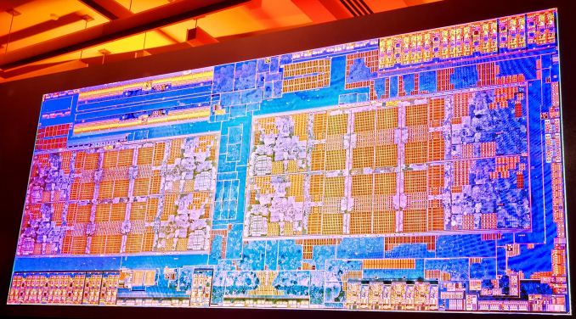
This is a picture of the underlaying silicon layout of the Zen Architecture.
Each block in the middle is a CCX.
For the Ryzen 1600, one core of each CCX is disabled.

Slide 5
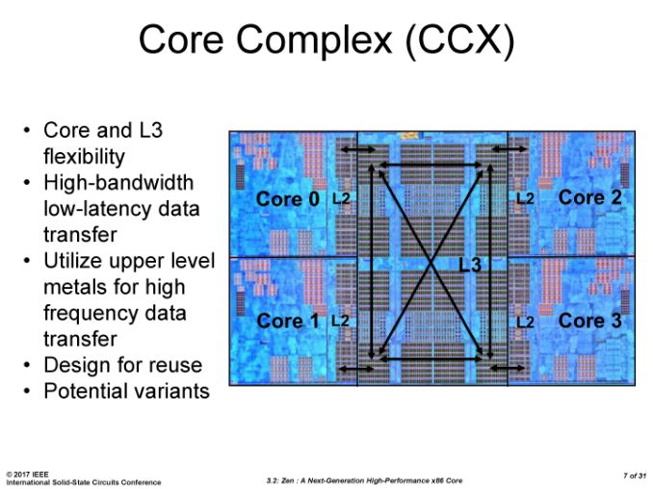
This is a picture of the CCX with cache layout.
For the Ryzen 1600, one core is disabled.
Used image from AnandTech.
https://www.anandtech.com/show/11244/the-amd-ryzen-5-1600x-vs-core-i5-review-twelve-threads-vs-four/2

Slide 6
This is a picture of the CCX with cache layout.
For the Ryzen 1600, one core is disabled.
Used image from AnandTech.
https://www.anandtech.com/show/11244/the-amd-ryzen-5-1600x-vs-core-i5-review-twelve-threads-vs-four/2

Slide 7
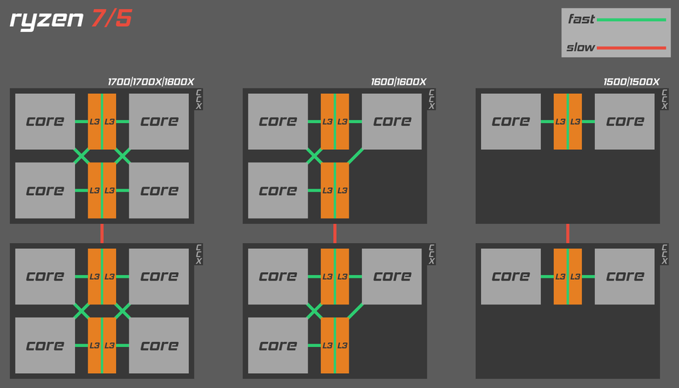
Zen block diagram showing interconnect between CCX and cores.
Found on Reddit. Original copyright owner unknown.
https://www.reddit.com/r/Amd/comments/5zq8av/ryzen_block_diagram_showing_44_33_and_22/

Slide 8
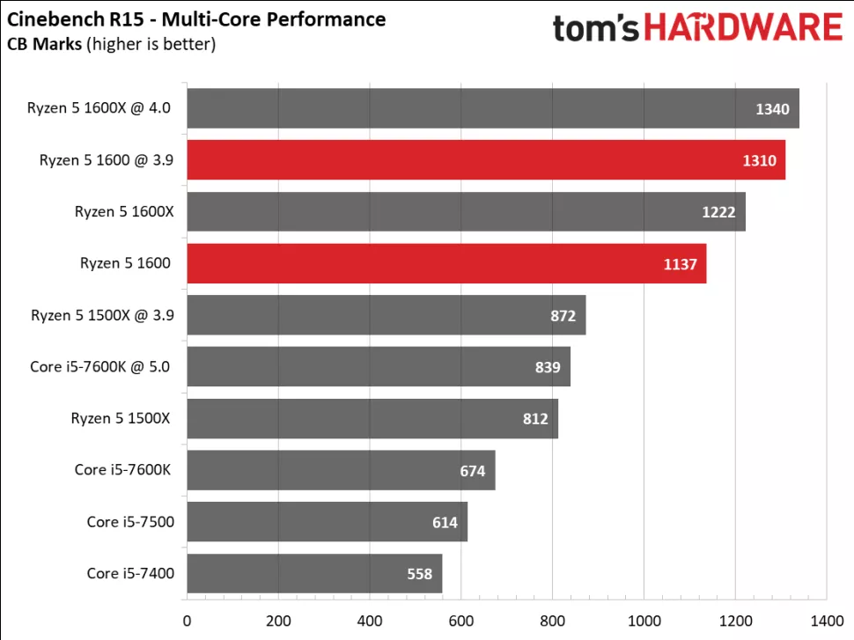
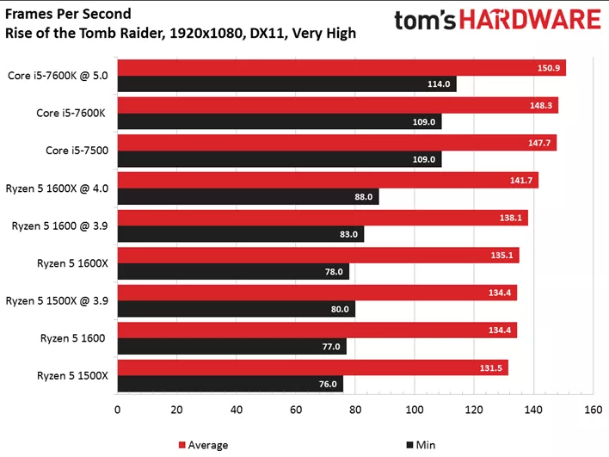
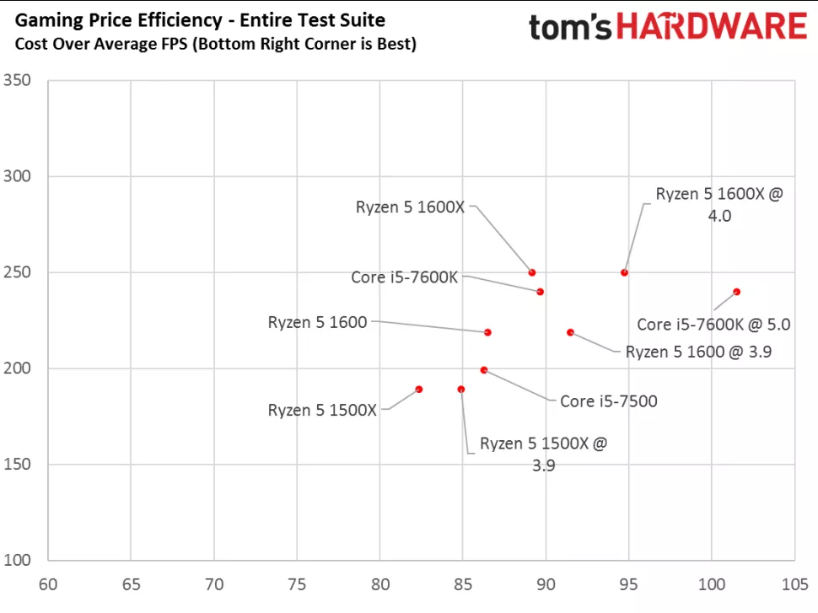
Ryzen 1600 Performance Comparison
Found on a Toms Hardware review of the Ryzen 5 1600.
https://www.tomshardware.com/reviews/amd-ryzen-5-1600-cpu,5073.html

Slide 9
Zen Architecture Details
The Zen architecture’s focus was on per-core performance with efficiency in mind.
The processors L1 cache uses a write-back technique for lower latency and higher bandwidth.
One major change with this architecture compared to previous architectures is the change to Simultaneous Multithreading from Clustered Multithreading.
Processors use a feature called Infinity Fabric which acts as a direct link between CCX’s. The IF is also tied to the clock speed of the installed DRAM modules so that data travels on synchronized clocks. This feature could also be used to link GPU’s directly to CPU’s.
This feature resulted in much lower latency data transfers and increased system efficiency.

Slide 10
Zen Architecture Details *Continued
The Zen uses improved branch predictions using a hashed perceptron system with Indirect Target Array.
This technique has been compared to a neural network by an AMD engineer named Mike Clark.
The processors use a dedicated stack engine to modify stack pointers.
This engine uses hardware registers and Arithmetic Logic Units to modify pointers.
The processors use a Micro-operation cache. This specialized cache holds decoded instructions that a processors checks to see if its current instructions have been decoded before. This allows the processor to bypass the decode stage of the pipeline if found.
This feature reduces the need to decode complex instructions multiple times.
The architecture uses a technique called eXtended Frequency Range to increase a processors frequency beyond its boost frequency, which itself is higher than the base frequency.
This technique will be elaborated on in the next slide in more detail.

Slide 11
eXtended Frequency Range
The Zen based CPUs use a base clock and boost clock during normal operations.
The base clock is the default clock of the CPU for all operations on all CCX’s. If the CPU is nearing its maximum usage ( i.e.: 100% usage) than the CPU will “boost” its frequency on some of its cores for a limited time to increase the CPU’s performance.
This technique is used with efficiency in mind. For less taxing operations, the CPU will use the base clock for lower power consumption and boost only when “necessary.”
The eXtended Frequency Range (XFR) is a system that boosts a CPU’s clock beyond both the base and boost clocks when certain metrics are within an acceptable range. It is used in conjunction with Precision Boost as an automatic overclocking tool.
This system allows a CPU to be overclocked “on-the-fly” without a user needing to manually adjust frequency and voltages in the BIOS/UEIF of their chosen motherboard.
This system is safer to use for the average user but is usually a milder overclock than when attempting to overclock a CPU manually.

Slide 12
eXtended Frequency Range * Continued
The XFR is a scalar system that increases the frequency in steps of 25MHz from the Boost mode.
The XFR uses a variety of voltage and temperature sensors to determine when and by how much should the system boost the CPU.
In simple terms, when the CPU’s voltage and temperature is below its maximum safe operating threshold, the system will increase the CPU frequency beyond its boost frequency when needed.
The system’s performance varied between CPU models and between identical models. Commonly known as “silicon lottery,” every CPU would have different XFR increases.
Another issue with the XFR system was the realizations that each model had effectively a hard limit on how high a CPU could boost to.
As the system has matured alongside future architectural improvements, the XFR system has allowed newer CPU models to increase this boosting behavior further than when first implemented.

Slide 13
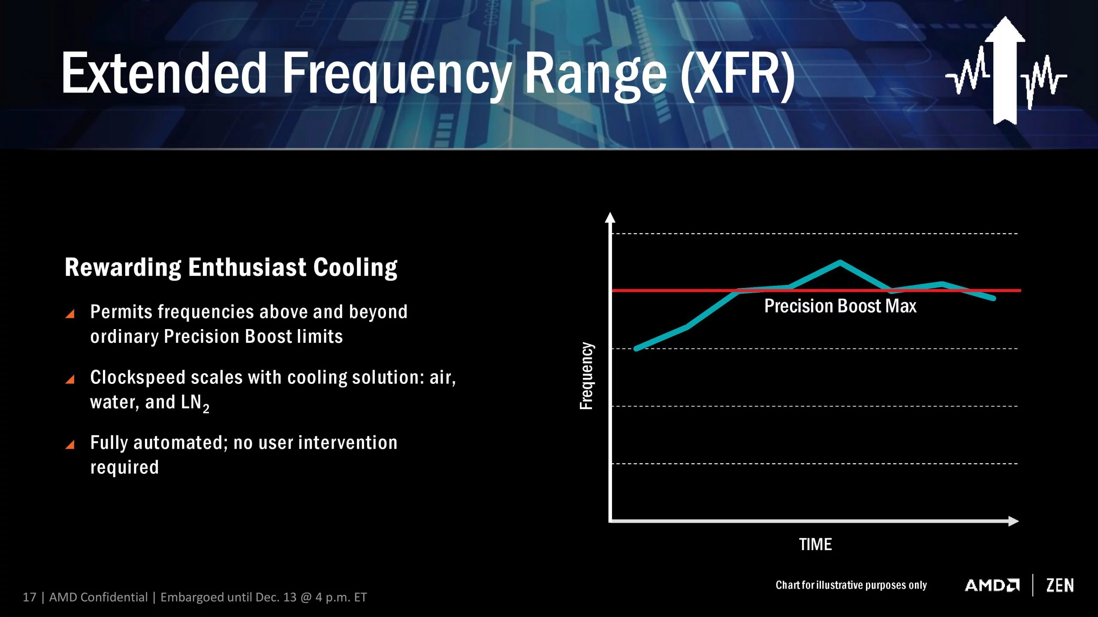
AMD promotional material for XFR. Found on Gear Primer.
https://www.gearprimer.com/wiki/xfr/

Slide 14
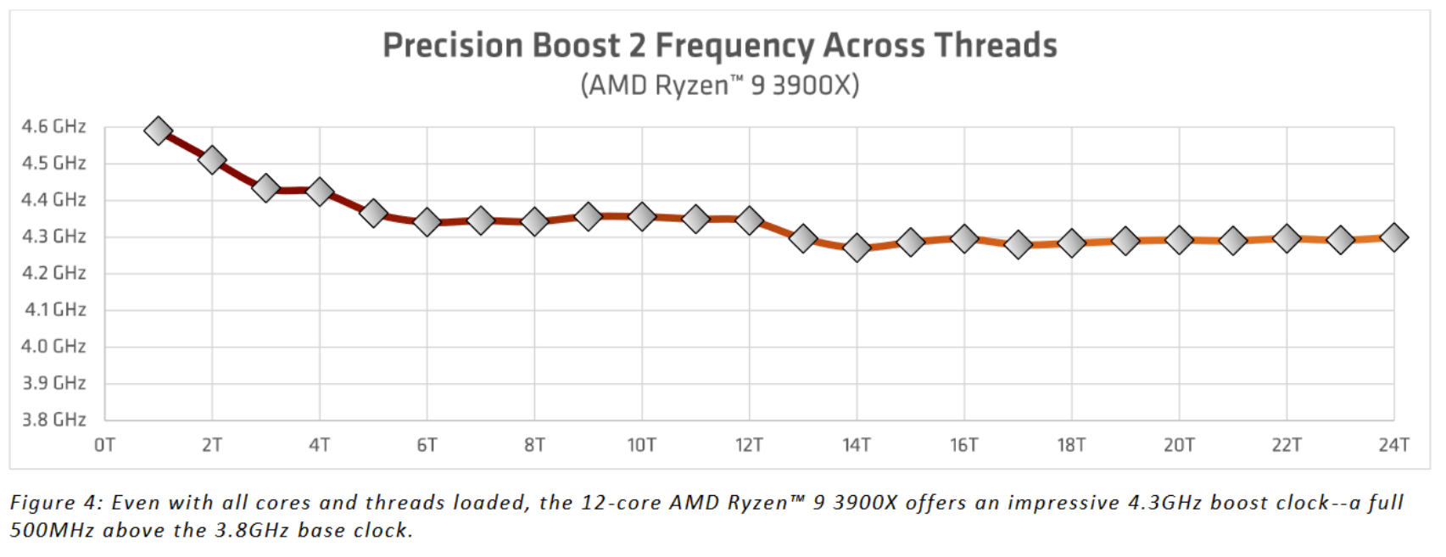
Newer XFR on a third generation newer CPU. The CPU is based on the Zen 2 architecture. Found on Gamers Nexus.
https://www.gamersnexus.net/guides/3491-explaining-precision-boost-overdrive-benchmarks-auto-oc

Slide 15
Summary and Conclusion
The Zen architecture was hailed as a vastly superior product in comparison to its previous Bulldozer architecture.
For the first time in many years, their processors were reaching parity with Intel processors of the same tier, with Ryzen multicore performance beating their competitors but having lower single-core performance.
Another benefit that was not discussed in previous slides was the price of the products. At the time of launch the processors were less expensive than Intel’s offerings.
Their motherboards were also less expensive during launch, although that might have been based on past observations of AMD processors being an inferior product and not worth the investment to lure customers.
The combination of superior performance from past AMD processors and less expensive system costs is what led me to build a new PC based on the Ryzen 5 1600.
The newer offerings from AMD is an even more tempting proposition to upgrade my current system with Zen 3 based CPUs.
The Zen 3 based CPUs are even the current performance leader in nearly any metric compared to Intel’s latest offerings.

Slide 16
Remote Collaboration Experience
I did not participate in a group to complete this project but do have other remote collaboration experiences from other classes that I will use for this discussion.
I have used google slides to create a presentation in a few of my previous classes as well as google document for research papers and essays.
These tools are convenient for remote collaboration as all users can contribute to a single project without needing to upload multiple copies. Instead of individuals working on separate parts, all users work on one project concurrently. This method allows each user to see each others work which will flow better than if each part was done separately. Comments could also be used to help explain your thoughts to others of the group. Overall, these tools improve group workflows and facilitates a more cohesive project.
I have also used an online service called discord. It is an online message board where users can join specific servers to communicate with others of the group. It is like older instant messaging programs but is geared towards communications with group members rather than individuals. This tool helped facilitate communications with other students during covid lockdown where in-person communication is not feasible.
Zoom is another tool that I have used. It is used for video conferencing in leu of in-person communications. Without this tool, online classes would be even more impersonal, where lectures would have to be prerecorded and acquiring help would be through email, which can be slow.

